Slide 1
Policy Transactions
1 April 2011
Notes:
Policy Transactions - <number>
Guidewire training materials contain Guidewire proprietary information that is subject to confidentiality and non-disclosure agreements. You agree to use the information in this manual solely for the purpose of training to implement Guidewire software solutions. You also agree not to disclose the information in this manual to third parties or copy this manual without prior written consent from Guidewire. Guidewire training may be given only by Guidewire employees or certified Guidewire partners under the appropriate agreement with Guidewire.

Slide 2
Lesson objectives
By the end of this lesson, you should be able to:
  Describe the types of transactions used to maintain policies
  View a policy on different effective dates
  View specific policy transactions
  Describe how PolicyCenter represents policies
  View PolicyPeriods
  This lesson uses the notes section for additional explanation and information.
  To view the notes in PowerPoint, choose View→Normal or View→Notes Page.
  If you choose to print the notes for the lesson, be sure to select “Print hidden slides.”
Notes:
Policy Transactions - <number>

Slide 3
Lesson outline
Policy transactions
Jobs
Representing policies
Viewing policies
Notes:
Policy Transactions - <number>

Slide 4
Life span of a policy
effective
date
expiration
date
expiration
date
policy term
renewal term
Length of time policy is in force determined by effective date (start date) and expiration date (end date)
  Period between these two dates is policy term
During life of the policy, one or more transactions can occur that change the policy
Notes:
Policy Transactions - <number>
The question "When does a policy end?" does not have a universal answer in the insurance industry. Personal lines carriers are more likely to view successive policy terms as a single policy; and Commercial Lines carriers are likely to view each term as a “policy”.
Assume for a moment that a given policy has a one-year term, and at renewal time a new policy number is not generated. (This is often the case, but not always the case with every insurance company.) At the end of that year, the policy is renewed, and the policy has the same policy number. Did the original policy end?
Some would say yes, that when the expiration date is reached, the policy ends. A new policy with the same number is created, but it is a different policy.
Others would say no, if the two time periods are governed by a document with the same policy number, then it is in fact the same policy.

Slide 5
Policy lifecycle transactions
Changes
Renewals
Non renewals
Submissions
Policy
Expiration
Policy created
Cancellations
Policy ends
Reinstatements
Rewrites
Notes:
Policy Transactions - <number>
The core of PolicyCenter revolves around the policy. Examples of policy changes are: creation of a new policy, renewal of a policy for a new term, and cancellation of a policy. The only transaction not included in the slide above is Audit. Audits can occur at any time during a policy term. A final audit can happen at the end of each policy term. Each of the above transactions is discussed in the slides to follow.

Slide 6

Submissions
submission
policy term
A submission is a transaction that creates a policy
  Qualifying candidate
  Getting one or more quotes
  Binding and issuing policy when acceptable quote is found
Most do not end with policy being issued because
  Applicant may not qualify
  May not be an acceptable quote
Notes:
Policy Transactions - <number>
All transactions (including submissions) have a create date, an effective date, and a close date.
The create date is the date that the transaction was initiated.
transaction close date or close date - the date the job was completed.
Effective date - the date that the information in the job becomes legal and binding. The effective date is the date that the transaction becomes effective. For example, you could create and complete a submission today for an auto policy that will not take effect until Monday of next week. Today would be the written date, but Monday of next week is the effective date.
In some cases, the transaction close date comes before the effective date. For example, a submission job is typically completed before the policy goes into effect.
In other cases, the transaction close date comes after the effective date. For example, a rewrite job that corrects a clerical error may be run several weeks after the policy has become effective, but the rewrite is effective at the start of the policy.
Issuance job: An issuance job always occurs with a submission job if necessary. There are times that a user may choose to bind a submission without issuing it. Perhaps you need to collect additional information that binding does not require but issuing the final policy contract requires, such as verification of eligibility for discounts in an auto policy. To start an issuance job, the policy must already be bound (submission), but not issued. In addition, there must be no other open jobs on the policy.

Slide 7
Policy Change
policy change
policy term
A policy change changes policy prior to expiration date
Some of the changes can be
  Coverables added to or removed from policy
  Coverages added to or removed from coverables
  Coverage terms modified
Notes:
Policy Transactions - <number>
A change transaction is also referred to as a "policy change". A "material change" is a change to a policy that affects what is covered. Policy changes typically involve material changes. Policy changes almost always involve a change to the policy's premium.

Slide 8
Renewals
renewal
No
Expires
Yes
policy term
renewal term
A renewal creates a new policy for another term, at the end of policy term
  May involve changes to coverables, coverages, or premium
If not renewed, policy simply expires
Notes:
Policy Transactions - <number>
An insured might choose to not renew a policy because he or she found a better-priced policy elsewhere, or because the policy premium has changed (perhaps because of changes in the industry or because of claims made against the original policy) and the insured does not wish to pay the new premium.
A carrier might choose to not renew a policy because the policy is considered financially unfavorable (perhaps because too many claims were filed against the policy).
Renewals can be highly regulated from state to state. There are restrictions in some states relating to non-renewal because of losses. There are also restrictions in many states relating to rate increases on renewals in excess of a given percent. And, there are restrictions in essentially all states relating to the carrier non-renewing without providing a specified amount of prior notice. Renewal regulation at a state level is largely a consumer protection issue. It is focused principally on personal lines (homeowners, personal auto) and harder to place on commercial lines.

Slide 9
Cancellations
cancellation
policy term
A cancellation ends policy before its expiration date
  Could be initiated by insured
    They found better price elsewhere
  Could be initiated by carrier
    Insured may have not paid premiums
Notes:
Policy Transactions - <number>
Cancellations are more easily executed by the insured than they are by the insurer. In many cases, the insured can choose to discontinue a policy and not need to have any reason for it. However, an insurer cannot discontinue a policy unless they can demonstrate some just cause, such as non-payment of premiums, purposefully inaccurate information provided at the time of submission, or fraud.

Slide 10
Reinstatements
cancellation
reinstatement
policy term
effective date
A reinstatement reinstates canceled policy with original terms
  Cancellation and reinstatement always have same effective date
    No lapse in coverage
Can happen when issue causing cancellation has been rectified
  For example, insured pays overdue premiums
Notes:
Policy Transactions - <number>

Slide 11
Rewrites
cancellation
rewrite
policy term
new policy term
A rewrite creates new policy from existing policy
  Typically done when some error occurred during initial submission of policy, and original policy does not reflect original intent of policy and
  New set of policy documents showing correct information is required
  Can have a lapse in coverage
  Rewrites are carrier specific and there is no universal definition of what might cause a rewrite
Notes:
Policy Transactions - <number>
A rewrite involves a change to a policy that is significant enough that it cannot be captured with a policy change. Although there is no absolute rule in the insurance industry that dictates when something must be done as a rewrite versus as a policy change, there is at least one common use cases for this type of transaction:
People who work for the carrier may make clerical errors when entering policy information. For example, during a discussion with an applicant, the underwriter might have agreed to provide a certain type of coverage but forgotten to enter it into the policy system. The documents issued from the submission job are wrong, and the insured may prefer to have a new set of documents drafted so that they have physical proof of exactly what was covered. In this case, a rewrite is required because the customer wants a full set of policy documents showing the correct information. If the requirement was to just make the change then a policy change could have handled this. This rewrite must have an effective date as of the start of the policy.
Rewrite feature allows you to do the following:
Full-Term Rewrite: A full-term rewrite replaces the original policy for the complete policy term. A full-term rewrite can have a lapse in coverage.

Slide 12
Mid-term rewrites
cancellation
rewrite
policy term
new policy term
A mid-term rewrite replaces a portion of the original term and allows you to rewrite the policy till the original policy end date or to a new end date
  Can create a lapse in coverage
Notes:
Policy Transactions - <number>
Mid-Term Rewrite: A mid-term rewrite replaces a portion of the original term and allows you to rewrite the policy to the original policy end date or to a new end date.
Every transaction has two different dates:
transaction close date or close date - the date the job was completed.
effective date - the date that the information in the job becomes legal and binding.
In some cases, the transaction close date comes before the effective date. For example, a submission job is typically completed before the policy goes into effect.
In other cases, the transaction close date comes after the effective date. For example, a rewrite job that corrects a clerical error may be run several weeks after the policy has become effective, but the rewrite is effective at the start of the policy.

Slide 13
Rewrite new account
rewrite
Source acct
policy term
Rewritten to target acct
new policy term
Rewrites policy to a new target account
  Takes data from an existing policy and creates a new policy with a new policy number in new account
Rewrites only canceled or expired policies to new account
Policy terms can have a gap between them
Notes:
Rewriting a policy to another account means moving the policy going forward to another account, but the policy history including earlier policy terms stay with its current account. For example, a young adult has a policy in his parent’s personal auto account. He graduates from college, and wants to move his policy to his own account. The insurer cancels his policy, and rewrites it to his new account.
When the user chooses to rewrite a policy to a new account, a rewrite new account job is created on the new account. This job takes data from an existing policy and creates a new policy with a new policy number in the new account. The policies on the new and old accounts cannot overlap. Because of this, no work order can be created on the source policy for a date later than the rewrite date (effective date of the rewritten policy). The policy does not exist on the source account after that date.
Unlike a rewrite job, a rewrite new policy job can have pre-qualification questions. Pre-qualification questions are discussed later in this course in the Submissions and Question Set lessons in detail.
Policy Transactions - <number>

Slide 14
Audits / final audits
audit
audit
final audit
policy term
(estimate → actual)
Audits are policy line (LOB) specific
A submission creates a policy with premium based on estimated information (such as the insured's revenue)
An audit updates policy by adjusting estimated amounts with actual data
  Can change policy premium
A final audit may happen at end of term to ensure policy reflects no estimated data
Notes:
Policy Transactions - <number>
Audits are unlike the other transactions for the following reasons:
Audits utilize the policy information and are tied to the policy periods but they cannot alter the policy contract.
Audits don’t have an edit effective date associated with them and do not get “issued”.
They can be executed at any time within the policy term. (The only other job that typically executes on a recurring basis is a renewal, and even that technically occurs only once per term.)
They are initiated and are viewable in a separate place in the PolicyCenter interface.
In case of workers' compensation line of business the premium is typically based on the payroll of the insured workers. One usually cannot say for certain how many workers will be employed during the policy term or what their salaries will be. Consequently, the payroll is estimated. Hence an audit is required to convert this estimated amount to actual data which in turn is reflected on the policy premium. Sometimes, an LOB that does not appear to be based on estimates may be subject to a Final Audit (for example Business Auto). Final Audits or other audit ‘reporting’ can be applied to several lines of businesses.
Premium Reports are available for workers’ compensation. Final Audits are available for worker’s compensation and general liability LOBs.
Premium Reports: Premium reports are a subtype of audit that are created for interim periods within a policy period. Premium reporting audits adjust estimated data, such as payroll, inventory, and course of construction reports. The primary distinction between the two types of activities is that an "audit" is executed by the carrier whereas a “premium report" is prepared exclusively by the policyholder (or their representative) and is not typically verified by the carrier. A premium report or a final audit is created using any of the available audit methods (voluntary, phone, physical or estimate).

Slide 15
Review: Policy transactions
submission
cancellation
change
reinstatement
car 1
+car 2
renewal
rewrite
audit
estimate
→ actual
Notes:
Policy Transactions - <number>
Also refer to slide 5 to review all the policy transactions.

Slide 16
Lesson outline
Policy transactions
Jobs
Representing policies
Viewing policies
Notes:
Policy Transactions - <number>

Slide 17
Jobs
submission
transaction
submission
job
Jobs coordinate all of the work associated with creating a new policy and modifying the policy
  Essentially "job" and "policy transaction" are synonymous
Work orders are used to execute a transaction
  Jobs/transactions are called work orders in the user interface
Notes:
Policy Transactions - <number>
The term "policy transaction" is more typical in the industry and is used in the user interface. The term "job" is used in the data model, in user interface configuration, and in business rules.
All jobs have an issue date and an effective date. For example, you could create a submission job today and issue it tomorrow, that will not take effect until Monday of next week. Tomorrow would be the issue date, but Monday of next week is the effective date. Also referred to as the “Transaction Close Date” in the Transactions list.
A work order is used to execute a transaction. Once it completes, it becomes a transaction on the policy but has an associated work order number.

Slide 18



Things that define job logic
Job Processes
Workflows
Wizards
Product model
Business rules
External systems
Notes:
Policy Transactions - <number>
Job Processes control the job flow and may use workflows. Workflows can be invoked by a job process class as appropriate for asynchronous processes. User actions in the user interface directly invoke methods on the job process. The other places where logic could be defined that could impact how a job is executed, include functions called by business rules and/or changes to the Guidewire’s default Java class model. But the majority of the configuration work occurs in the above listed six categories.
With the exception of the Product model, none of the features are unique to PolicyCenter. They are platform-level features that are also used in ClaimCenter and BillingCenter. Because policy processing involves more complex business processes than claims processing, PolicyCenter makes more extensive use of wizards and workflow.
The categories listed above are defined on the following slides.

Slide 19
Job processes
Submission process snippet
Start submission
Edit submission
Save draft
Quick quote
Full app quote
Bind and Issue
Withdrawn
A job process controls the flow of a job by using:
  Gosu classes such as SubmissionProcess.gs
  Wizard actions that can directly interact with the job and policy revisions
  Workflows
Job processes are flexible for user driven logic
Notes:
Policy Transactions - <number>
PolicyCenter uses both workflows and job process. Job processes are exported to customer build but not editable because they are marked @Export and @ReadOnly. They should be extended to modify job process. The JobProcess.gs Gosu class contains methods that are common to all jobs and can be viewed in Studio. For example, consider the above job process steps involved in a submission job process. The SubmissionProcess.gs class exists in Studio and has the actions taken within a submission job.

Slide 20
Workflows
Workflow is a component for executing custom
business processes asynchronously
The building blocks for a workflow process are:
Start
Auto
Step
Manual
Step
Activity
Step
Message
Step
Outcome
Finish
Notes:
Policy Transactions - <number>
Workflow is recommended for automation and coordination of activities (including manual activities) between PolicyCenter and external systems. Workflows are used for asynchronous steps and for automated processes. The workflow is called by the job code and by rules in the rule sets. In some cases, the wizard calls the workflow and sends control back to the wizard.
In the default installation, only renewal and cancellation jobs have workflows. Cancellation has a workflow that handles the potential waiting period between the time the cancellation is scheduled or issued and completed.

Slide 21
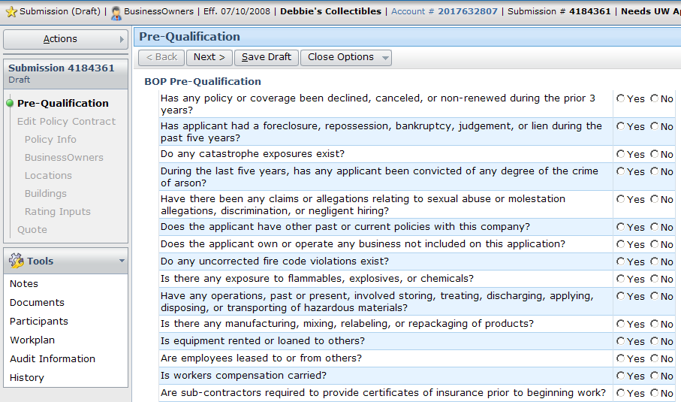
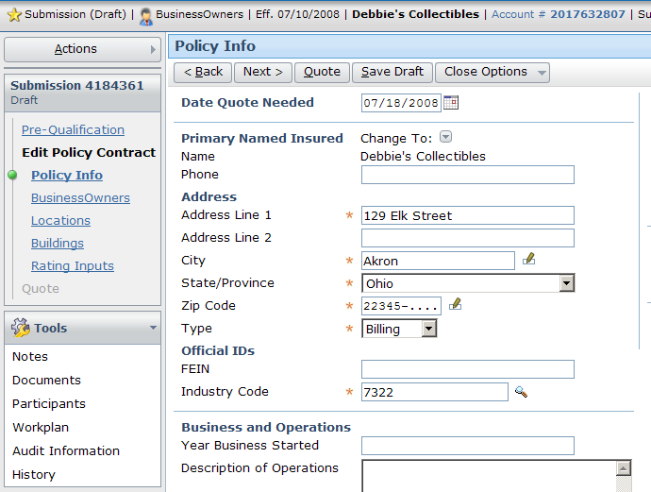
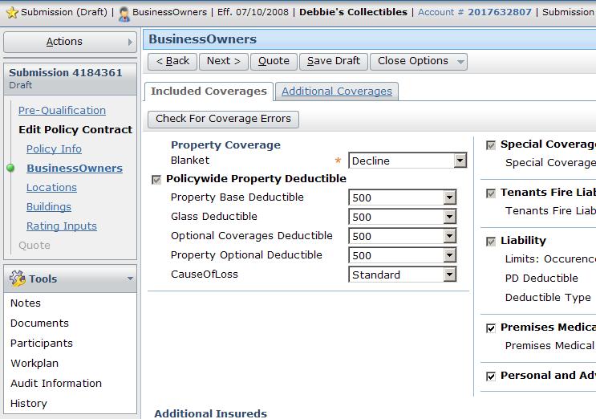
Wizards
A job wizard is a series of screens that
collect information during a job
  Information varies based on job type and
  line of business
Notes:
Policy Transactions - <number>

Slide 22
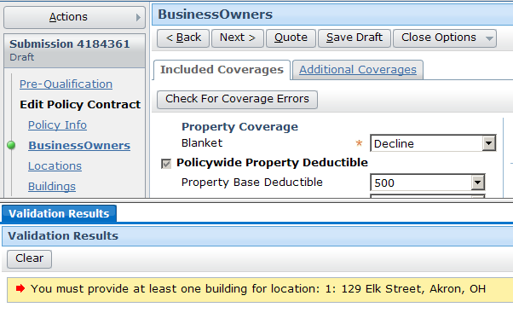
Business rules
Notes:
Policy Transactions - <number>
The job code and workflows access the rule sets. Business rules are often implemented and executed within Gosu classes. Inserting logic in the job code allows for a more centralized job flow and is easier to debug. The default application puts most of the business logic in the Gosu job process code. Rules can be used to check for a simple set of conditions and then follow with a set of simple actions. Rules are grouped by function for the purpose of customizing a process, such as a submission, to follow established business procedures.

Slide 23
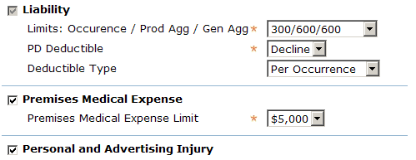
Product model
These coverages are added automatically
coverage is required
coverage limit can be set to one of eight values
coverage can be declined
Notes:
Policy Transactions - <number>
The product model is basically a product configurator. It specifies the structure of each product (what coverages are available, what terms are available for those coverages, what questions are asked during submission to establish qualification, and so on).

Slide 24

External systems
information about policy draft
quote
rating engine
PolicyCenter periodically calls external systems during job processing
  For example, during submission, typically calls to external rating engine to get a quote for given draft
Notes:
Policy Transactions - <number>
External systems are not discussed in detail in this course. For further information, refer to the PolicyCenter documentation.

Slide 25
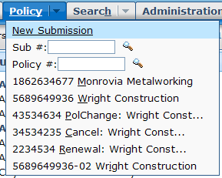
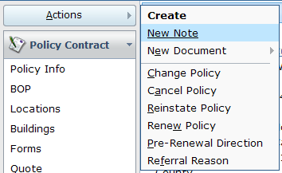
Initiating jobs
no policy is in focus
submission
change
cancellation
Through menu actions, or automatically by PolicyCenter
Notes:
Policy Transactions - <number>
The jobs that can be executed depend on the state of the policy. For example, you cannot initiate a reinstatement job against a policy that hasn't been cancelled.
Submission, policy change, cancellation, reinstatement, rewrite, and audit jobs are typically initiated by the end user through menu actions.
Renewal jobs are typically initiated automatically by a PolicyCenter batch process.
Also cancellation jobs might be initiated automatically by a billing application due to non-payment.

Slide 26
Lesson outline
Policy transactions
Jobs
Representing policies
Viewing policies
Notes:
Policy Transactions - <number>

Slide 27

History of a policy
policy created
04/20/08
second auto added
07/20/08
teen driver
added
10/20/08
renewal
(premium changed)
04/20/09
$270
$450
$920
$990
Typically, policy changes over time
  Coverables and coverages are added or removed
  When policy is renewed, rates (and therefore premium) may change
  Policy could be canceled (and possibly reinstated)
Notes:
Policy Transactions - <number>
If a policy is created, not modified, and then either canceled before the renewal date or not renewed at the expiration date, then the policy never changed over time. In all other circumstances, the policy changes over time.

Slide 28
PolicyPeriods
A PolicyPeriod is one "version" of the policy
  Has effective date and expiration date
Model time is the actual real-world time when policies are created or jobs are bound
Model time
4/20/08
7/20/08
10/20/08
04/20/09
policy created $270
+ second auto $450
+ teen driver $920
3 versions, so 3 PolicyPeriods:
04/20/08 – 04/20/09
Renewal $990
1 PP and 1 PT : 04/20/09 – 04/20/10
1 PolicyTerm: 04/20/08 – 04/20/09
Notes:
Policy Transactions - <number>
Policy Transactions - <number>
The PolicyPeriod entity contains information about all effective dates within a single PolicyTerm or period which means that every change in policy is represented by a PolicyPeriod entity at the root of a complex graph of sub-objects such as policy lines, vehicles, coverages, and many others. The entire hierarchy of Guidewire entities is cloned in the database into new rows during policy changes, renewals, or other jobs that result in cloning everything in a branch. The cloned branch is updated with the changes (such as delete a driver or add a new car etc.). The changes made to this cloned branch will be visible only when a user views the policy from that branch’s effective date. This cloned branch becomes the base to be cloned for future changes and so forth. (In contrast, a submission job’s branch is not cloned from another branch.)
Policy term and policy periods:
PolicyPeriod
The PolicyPeriod entity stores information for a specific revision of the contractual period of a policy. A revision occurs anytime a job occurs on a policy. A submission creates the first revision. Each additional transaction on the policy (such as a policy change) creates a new revision. Therefore, a policy almost always has multiple revisions, with one PolicyPeriod entity for each revision. During the contractual period, only one PolicyPeriod entity is in effect at a time. A new revision is created when you process a policy change that adds a car to the policy. The EffectiveDate for the car is several months into the contractual period, and the ExpirationDate extends to the end of the period. PolicyCenter clones a new PolicyPeriod entity and its subentities and adds an entity for the new car. The contractual period now has two PolicyPeriods. The new PolicyPeriod entity is in effect. The old PolicyPeriod entity is preserved as a historical record of the policy.
(continued)

Slide 29
(Notes only slide)
Notes:
Policy Transactions - <number>
PolicyTerm
A new PolicyTerm is created whenever the policy contract is completely recreated. This occurs with a new policy (submission), a renewal, or a rewrite of an existing contract. A new PolicyTerm is not created when you amend a policy contract with a policy change job.
The terms “policy period” and “policy term” are used pretty much synonymously throughout the industry. The PolicyPeriod entity represents one historical version of a particular “policy period” or “policy term”, but there can be many PolicyPeriods for one “policy period” or “policy term”, all representing what the policy looked like at different points in model time. Thus “PolicyPeriod” is somewhat different than “policy period”. In order to avoid confusion about which we are talking about at any given time, throughout this course we will use the term “policy term” to refer to a “policy period” or “policy term”, and use “PolicyPeriod” only to refer to the entity, that is, a specific version of a “policy term”.

Slide 30
Applying jobs to policies
4/20/08
8/20/08
12/20/08
4/20/09
sub-mission
$270
policy change
$450
policy change
$920
renewal
$990
policy term: 04/20/09 – 04/20/10
policy term: 04/20/08 – 04/20/09
When job becomes effective, it changes nature of policy
  Each job has a transaction effective date
  Transaction generally applies until the end of the policy term
Notes:
Policy Transactions - <number>
In a simple world, only one job would be run against a policy at a given time, and every job would be executed in the order in which it was supposed to take effect. In practice, this is not always the case.
"Preemption" is a policy transaction phenomenon that occurs when two or more jobs are running on a policy at a given time. This can cause a problem because both jobs are based off of the same version of the policy. When one job finishes, the state of the policy changes, and this could cause conflicts for the other job. (For example, an auto policy could have one car on it. Then, a change job is executed to add a motorcycle to it, and a second change job is executed to add a truck to it. If the motorcycle job finishes first, then the car policy becomes a car + motorcycle policy. However, the truck job was started on a policy that had just a car on it. When that job finishes, the motorcycle cannot be discarded. Somehow, the results of the motorcycle change job and the truck change job must be reconciled.)
An "out of sequence transaction" (also referred to in the industry as an "out of sequence endorsement") is a policy transaction that is executed after some other policy transaction but becomes effective before that policy transaction. The second job changes the state of the policy that could impact how the first job should be executed. (For example, in January, an auto policy could have one car on it. Then, a change job is executed to add a motorcycle to the policy as of June. After that, a change job is executed to add a truck to the policy as of March. The second job must be treated in two pieces: March to June (in which only a truck is being added) and June forward (in which a car and a truck are being added).
Preemptions and out-of-sequence transactions are discussed later in this course in the Out-Of-Sequence Transactions lesson under Policy Transactions.

Slide 31
Transaction effective dates within a policy term
4/20/08
8/20/08
12/20/08
4/20/09
sub-mission
transaction effective 4/20/08
(superseded)
policy change
transaction effective 8/20/08
(superseded)
policy change
transaction effective 12/20/08
new policy term
renewal
Transaction
effective 4/20/09
Every transaction has effective date that identifies when it goes into effect
  Every transaction within a policy term supersedes the transaction effective before it
Notes:
Policy Transactions - <number>
Policy Transactions - <number>
Review that the effective date of a policy is the date the policy is in effect. The expiration date is the date the policy expires. The diagram above represents the effective dates of each job, not the date the job was actually run.
For example, a renewal job often takes several weeks (or even months) to run. Therefore, it must be executed well in advance of the expiration date. The "renewal" label shown above indicates when the job became effective. The date the job was started would be well in advance of the date indicated by the "renewal" arrow. The data model uses the term “Edit Effective Date” for job policy periods so that it is not confused with the policy term dates. Although they both show up as Effective Date on the user interface.
For the example above, the policy term has an effective date of 4/20/08 and an expiration date of 4/20/09. But the renewal job has an edit effective date of 4/20/09 and an expiration date of 4/20/10. The policy term dates are different from the job dates.

Slide 32
Lesson outline
Policy transactions
Jobs
Representing policies
Viewing policies
Notes:
Policy Transactions - <number>

Slide 33
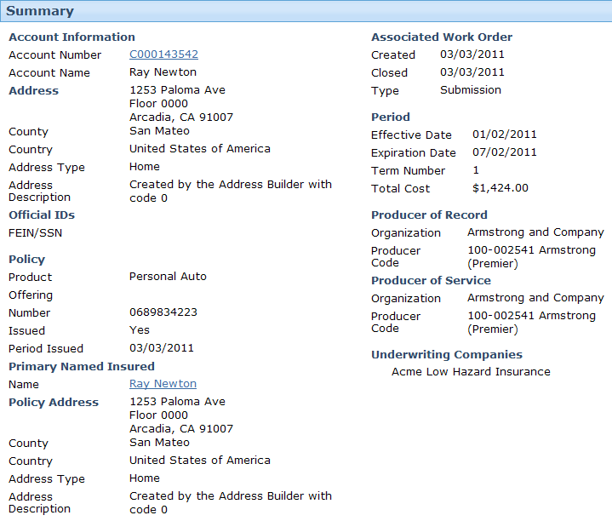
Viewing policy information
Notes:
Policy Transactions - <number>
The user can see what the policy looks like on any particular effective date by using the date selector. You can view any policy term and the latest PolicyPeriod for that term by entering the "as of" date in the date selector at the bottom of the Policy Contract links and entering return. But whatever date you select (as long as it’s within the same policy term) you are viewing the same PolicyPeriod.
The “Associated Work Order” section displays information about the work order that created this period.

Slide 34
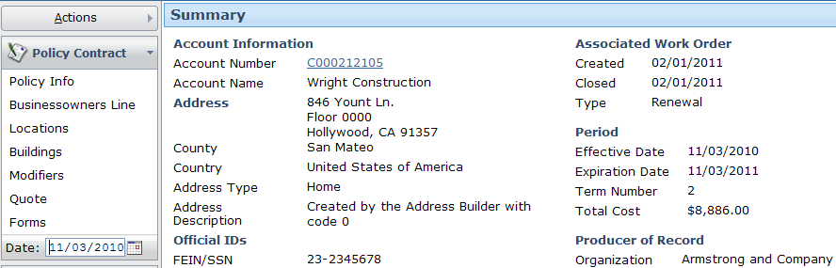
Policy term “In force”
Policy terms in force have no special warning at top
Notes:
Policy Transactions - <number>

Slide 35
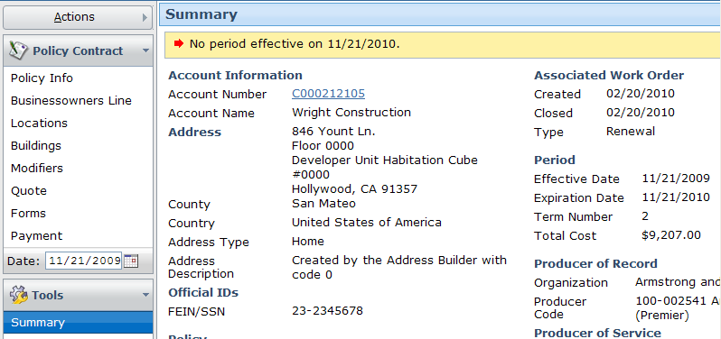
Policy term exists but not in force
Notes:
Policy Transactions - <number>
When viewing a term of the policy other than the current term, an error appears at the top of the screen.

Slide 36

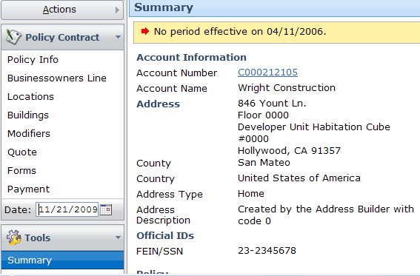
No policy term exists
Notes:
Policy Transactions - <number>
If you attempt to view the policy as of a date when the policy is not in force (either because the date is before the first submission, after the current expiration date, or in between a cancellation and a reinstatement), the system displays an error message stating "No period effective on <date>".

Slide 37
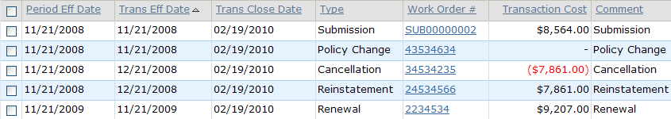
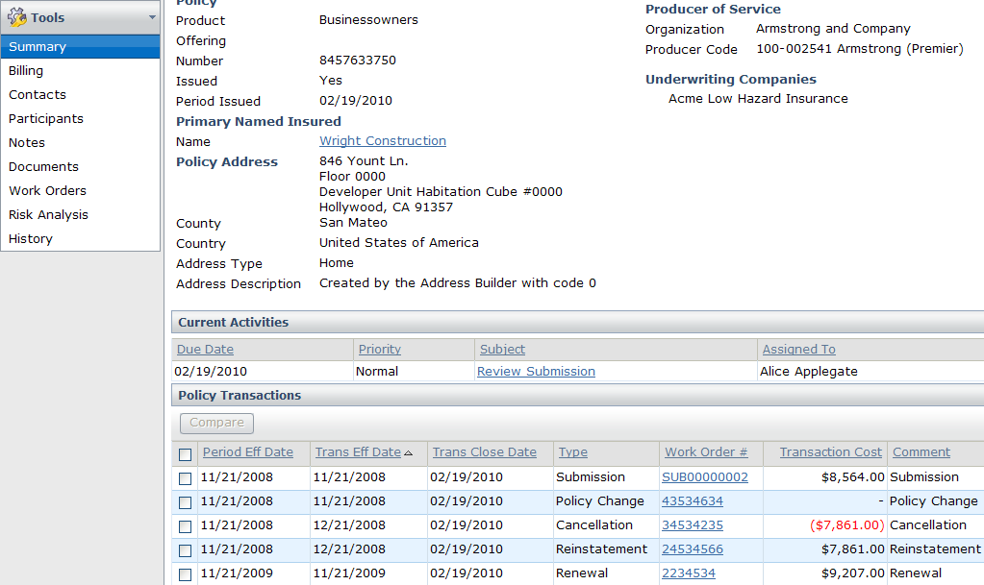
Viewing policy transactions
Notes:
Policy Transactions - <number>
All of the jobs executed against a policy are listed in the "Policy Transactions" list in chronological order by the effective date of the transaction.

Slide 38
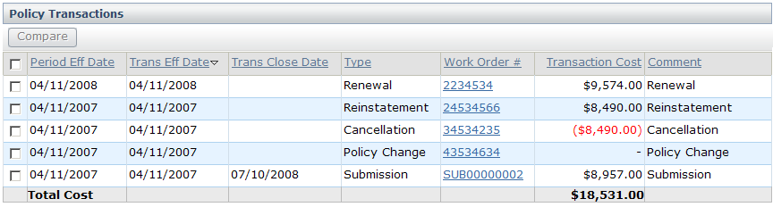
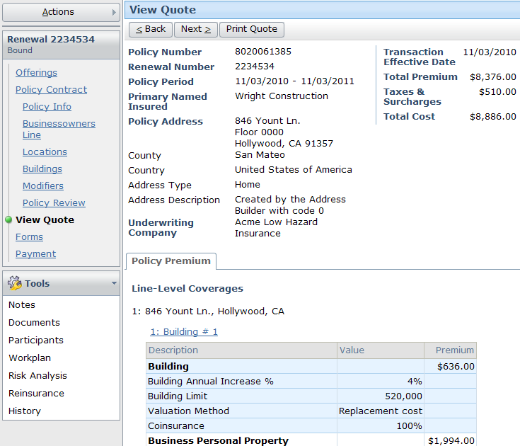
Viewing job data
Notes:
Policy Transactions - <number>
When you click a link in the "Work Order #" column of the Policy Transaction list, PolicyCenter displays the data collected by the job. You can see all information entered by the users who worked on the job. However, you cannot modify any of the information.

Slide 39
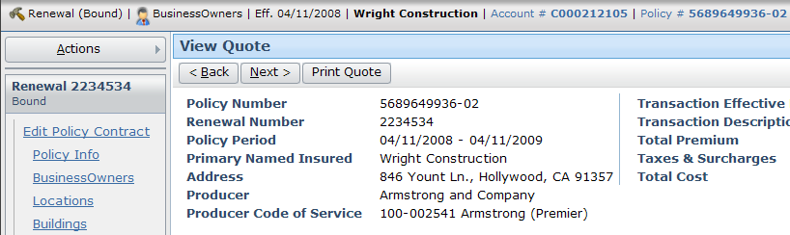
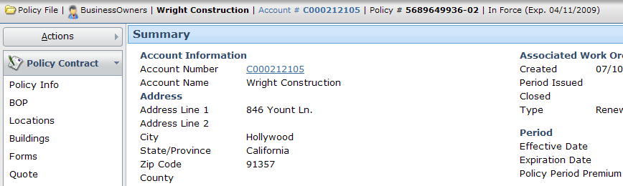
Returning to policy
Notes:
Policy Transactions - <number>
When viewing a policy job, you can return to the policy itself by clicking the policy number in the info bar.

Slide 40
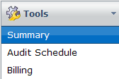
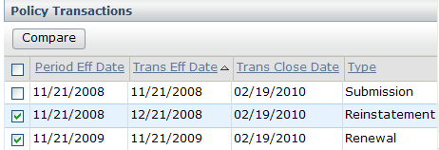
Comparing policy transactions (1)
Notes:
Policy Transactions - <number>

Slide 41
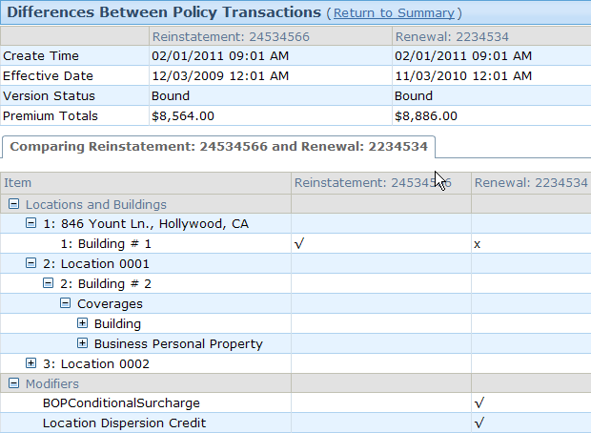
Comparing policy transactions (2)

Slide 42
Lesson objectives review
You should now be able to:
  Describe the types of transactions used to maintain policies
  View a policy on different effective dates
  View specific policy transactions
  Describe how PolicyCenter represents policies
  View PolicyPeriods
Notes:
Policy Transactions - <number>

Slide 43
Review questions
What are the two things that can occur when a policy reaches its expiration date?
Name three transactions that can become effective in between a policy's effective and expiration dates.
A submission makes a policy effective as of Monday. A policy change makes a change that is effective as of Wednesday. As of Friday, how many policy terms exist? How many PolicyPeriods exist?
If a policy becomes effective as of March 1, 2006, what happens if you attempt to view the policy as of February 1, 2006?
Notes:
Policy Transactions - <number>
Answers
1. The policy could be renewed, or the policy could simply expire.
2. Possible answers:policy change, cancellation, reinstatement, rewrite. (Audits don’t really become “effective” like the other jobs.)
3. In a business sense there is just one “policy term” or “policy period”. However, in PC4.0 there are two PolicyPeriod entity instances created . The second PolicyPeriod entity instance (created as a consequence of the “Policy Change” transaction) supersedes the first one (created as a consequence the original “Submission” transaction). Most importantly, both PolicyPeriod entity instances cover the entire duration of the policy term, from Monday to the expiration date of the policy. So there are two PolicyPeriods. The second policy period supersedes the first one. Both PolicyPeriods cover the entire time of the term, from Monday to the expiration date of the policy.
4. The user interface states that there is no policy in effect as of the given date.

Slide 44
Reservation of rights
Copyright © 2011 Guidewire Software, Inc. All Rights Reserved.
This file and the contents herein are the property of Guidewire Software, Inc. Use of this course material is restricted to students officially registered in this specific Guidewire-instructed course. Replication or distribution of this course material electronically or in paper format is prohibited without express permission from Guidewire.
Guidewire, Guidewire Software, Guidewire ClaimCenter, Guidewire PolicyCenter, Guidewire BillingCenter, Guidewire ContactManager, Guidewire InsuranceSuite, Guidewire Education, and the Guidewire logo are trademarks or registered trademarks of Guidewire Software, Inc. All other trademarks are the property of their respective owners.
Notes:
Policy Transactions - <number>

